Slide 1
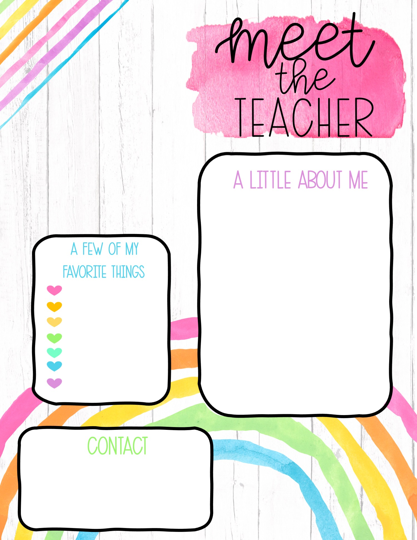

Hello! My name is Mrs. Lovorn, but I usually go by Mrs. Love. This is my 5th year of teaching, and I couldn’t be more excited! I have been teaching at Northside for the past 3 years and I absolutely love it. I have a sweet little baby girl and two basset hounds that keep me busy 24/7. I look forward to getting to know all my wonderful new students this year as well as their amazing parents!
Disney
Coffee
Dogs
Fall/Winter
Football
Naps
Cookies
Email: mlovorn@pearlk12.com

